Slide 1

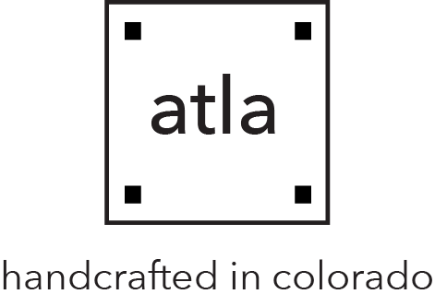

An Engineers Journey in Aesthetic of Design: Functional Aesthetics

Slide 2
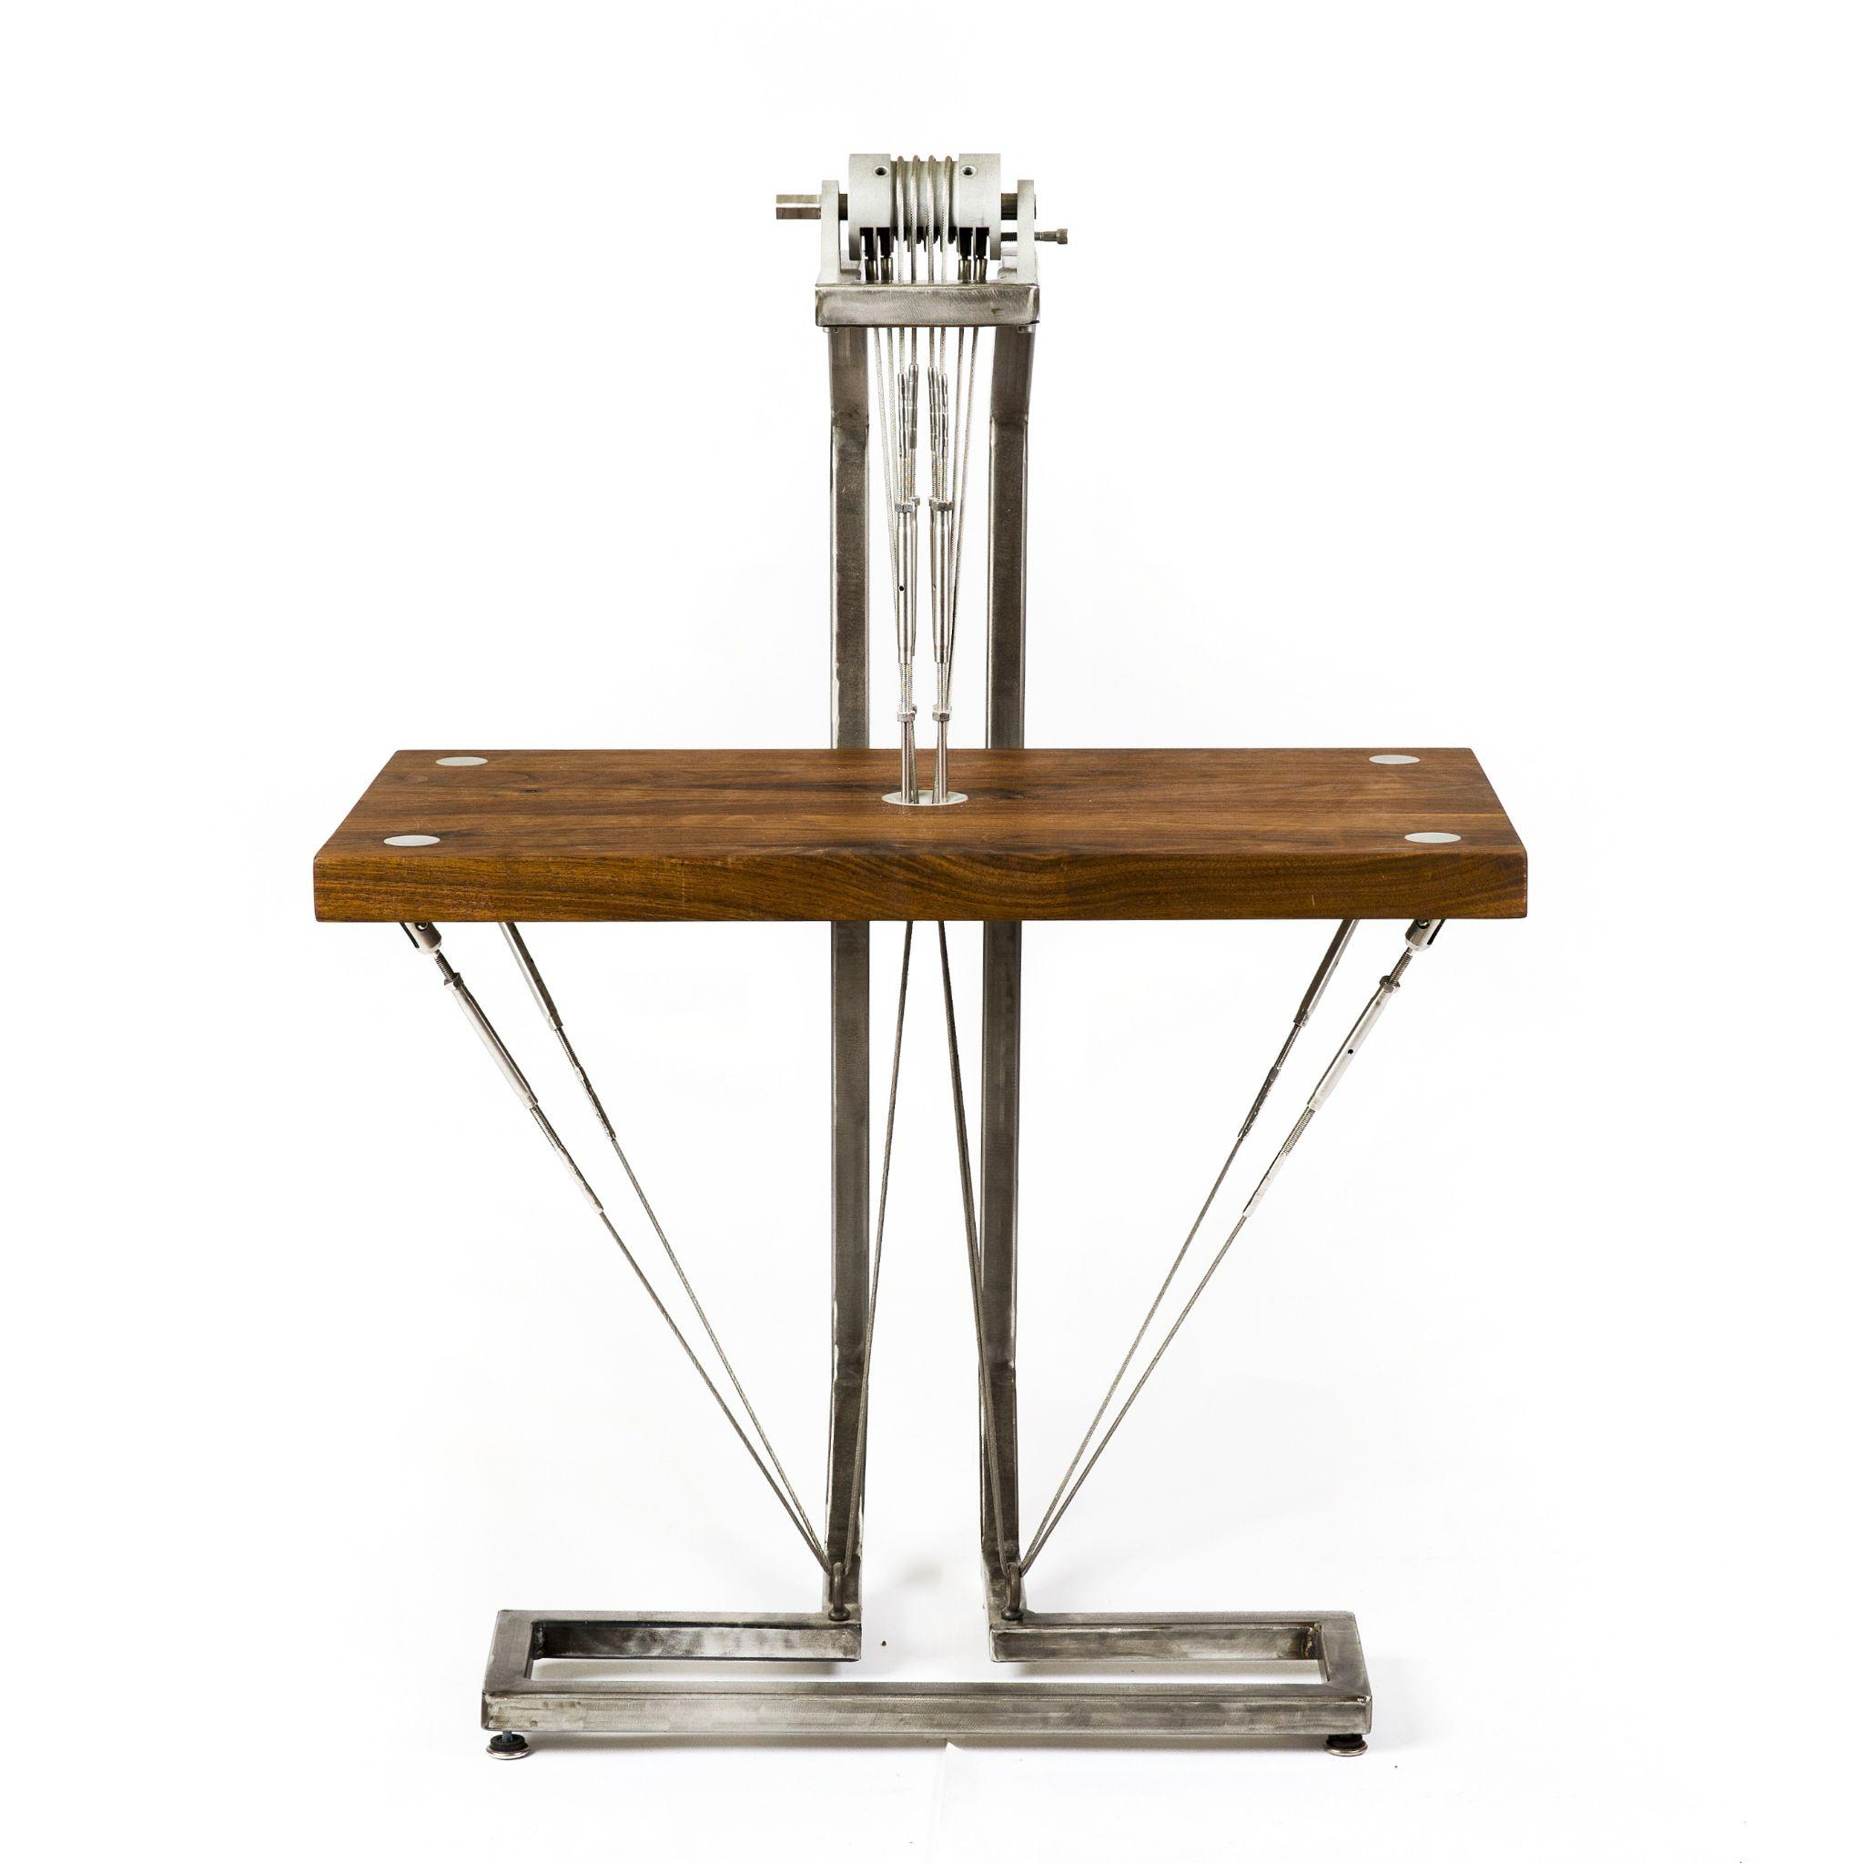
Grew up in Washington DC
Lots of art and welding as a child
Studied Mechanical Engineering at CU Graduating in 2015
Worked at the CIRES machine shop on campus as a student, later as faculty member.
Aesthetics in Design: where I built my first piece of furniture (hanging table)! Summer 2012?

Slide 3
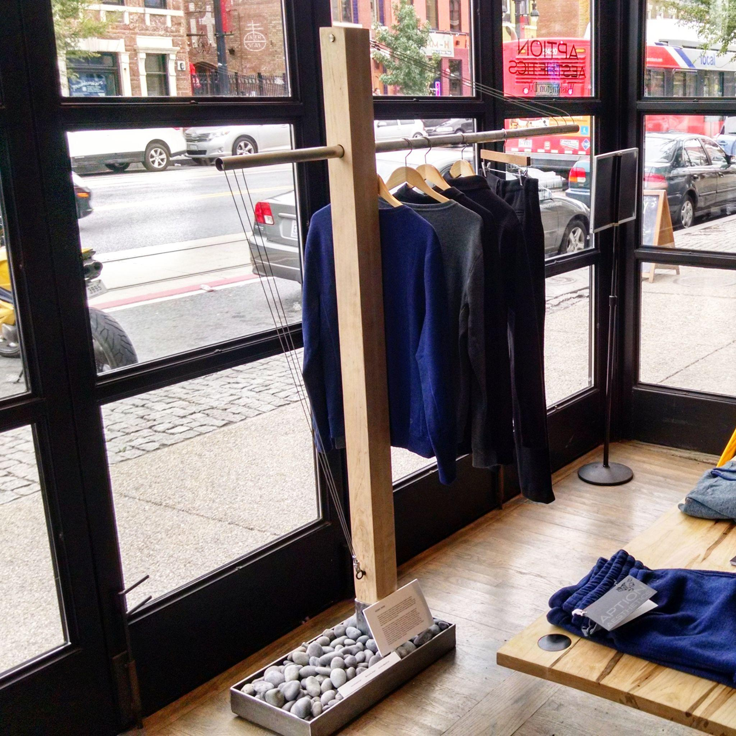
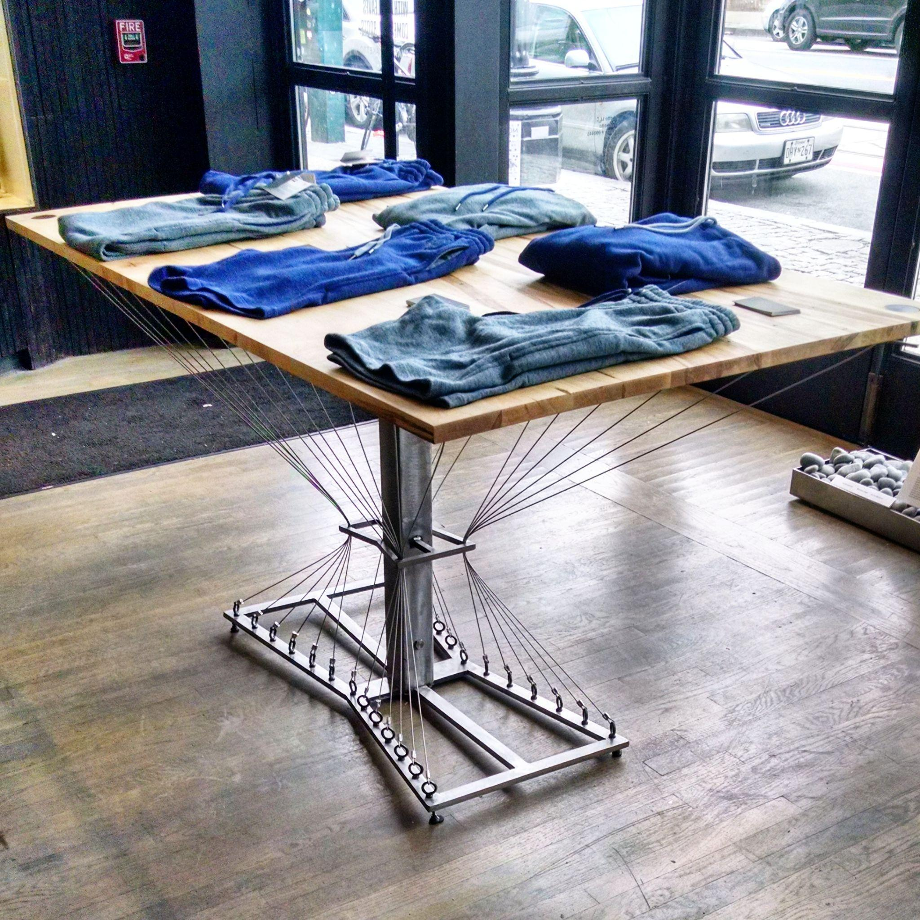
First Commission in fall 2015 “Aption” Continued with wire rope pieces.

Slide 4
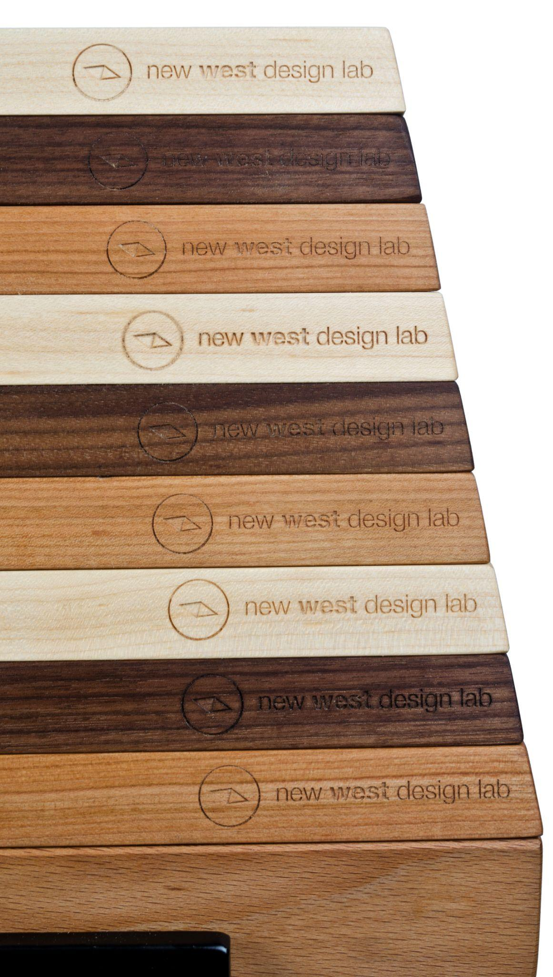
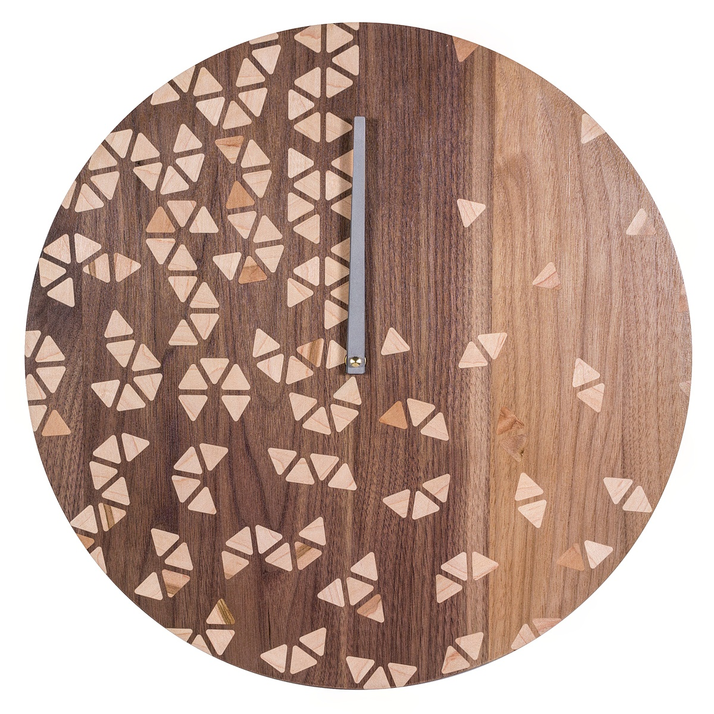
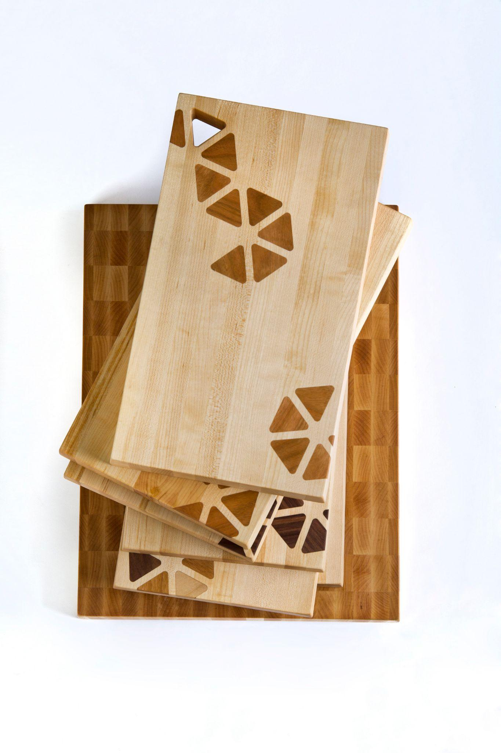
Winter/Spring 2016: Started first business “New West Design Lab”

Slide 5
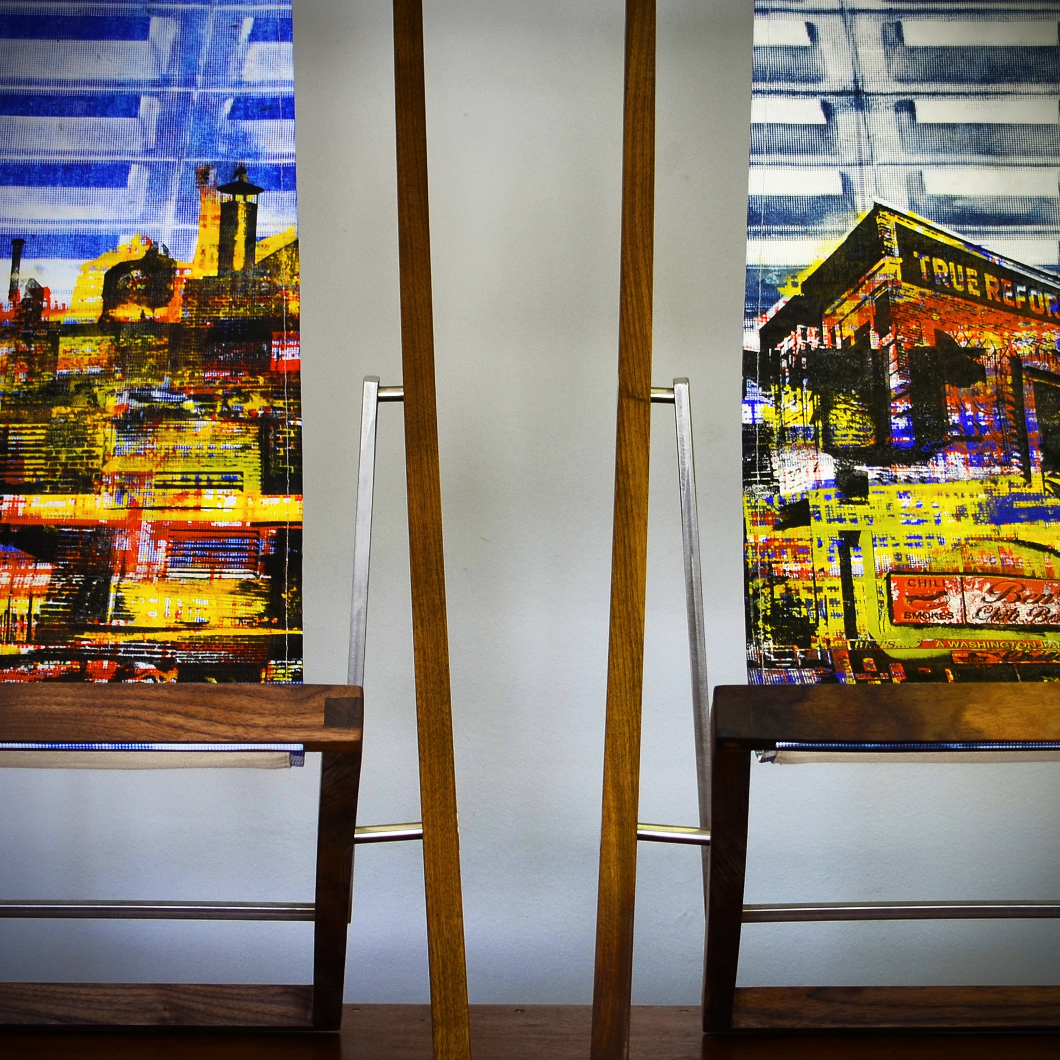
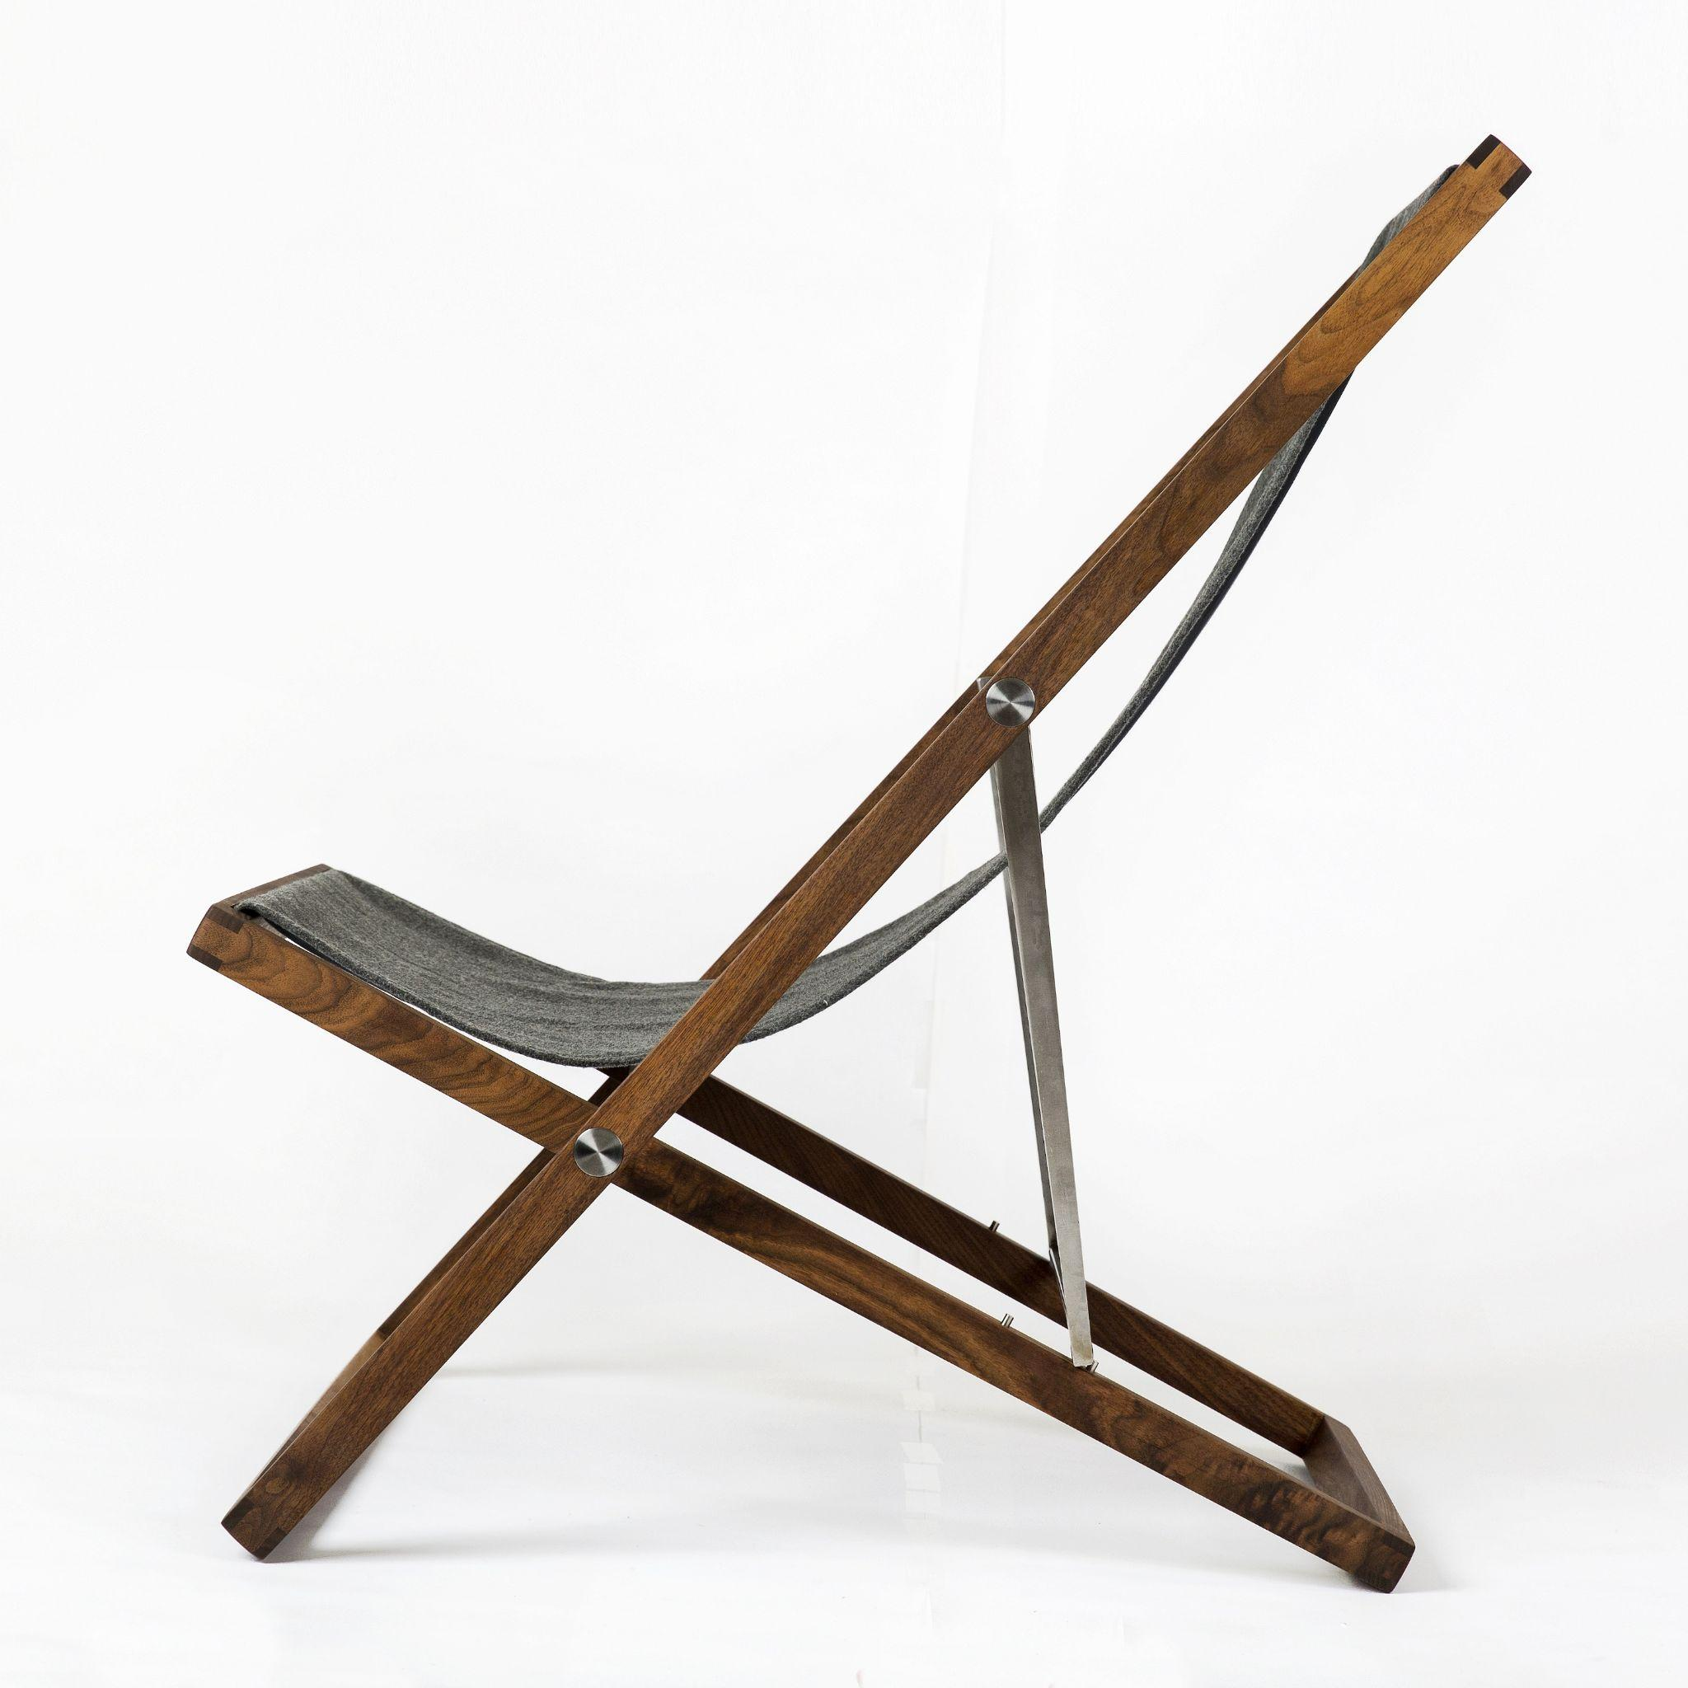
2016: 901 chair | Michael Crossett collaboration

Slide 6
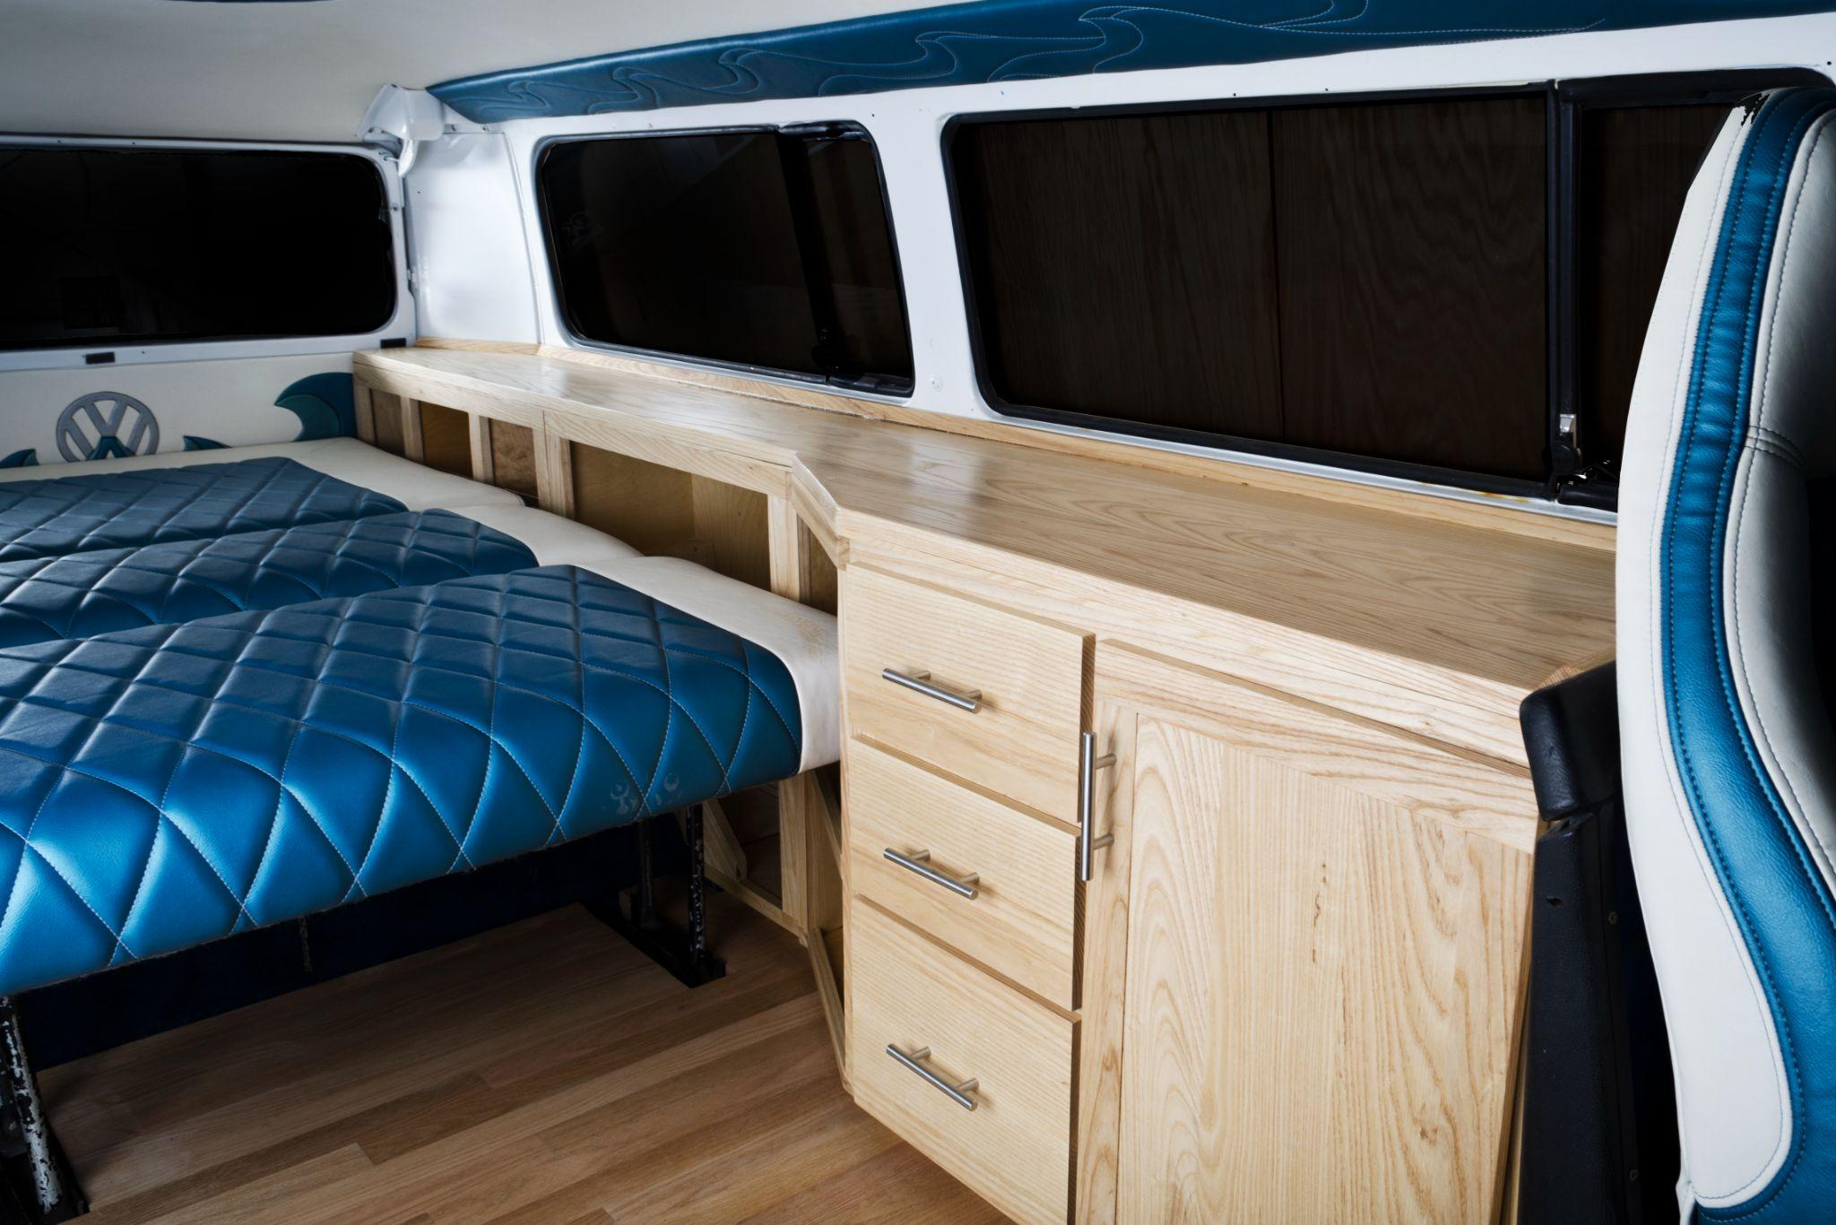
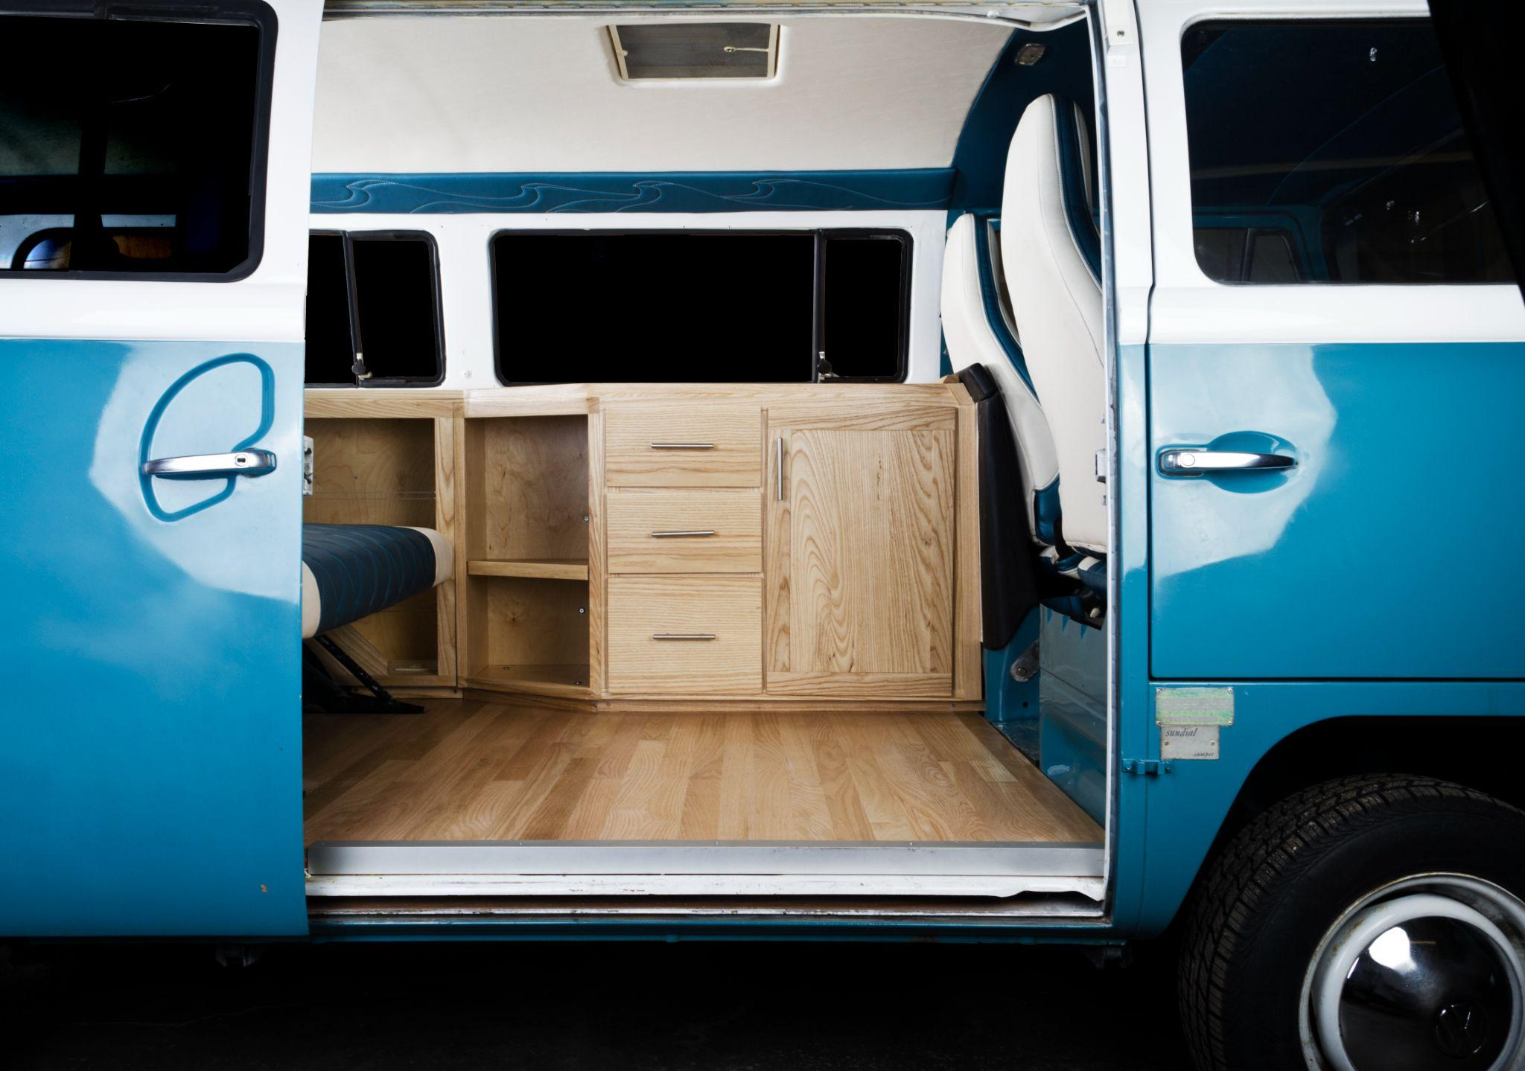
Spring 2017 decided to focus full time on New West leaving CIRES

Slide 7
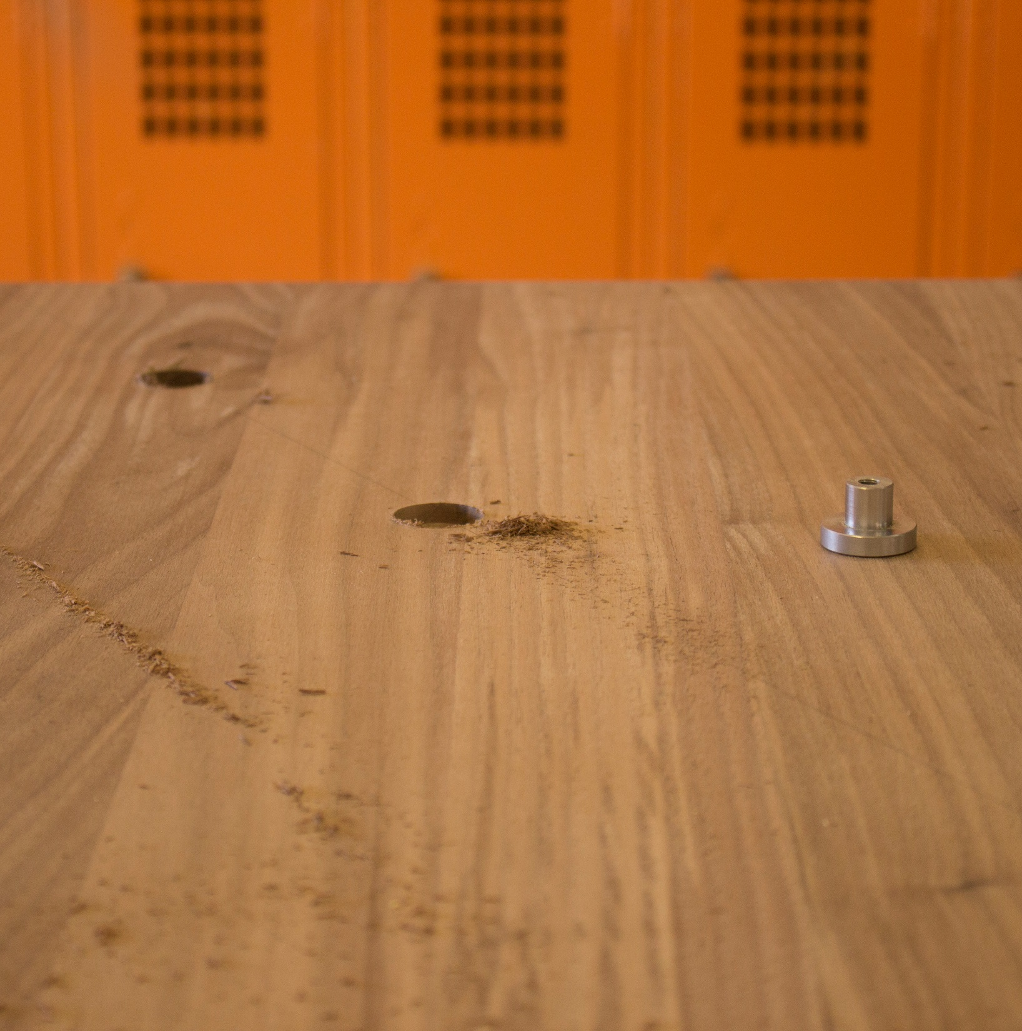
Fall 2017: formed ATLA
Relentless pursuit of quality
- Focused on simple, timeless furniture
- Thoughtful designs intended to last for generations
- Custom all-metal joinery system attaches the legs
- Robust connection that enables customization
- Flat packs for shipping and transportation
- Easy assembly for installation

Slide 8
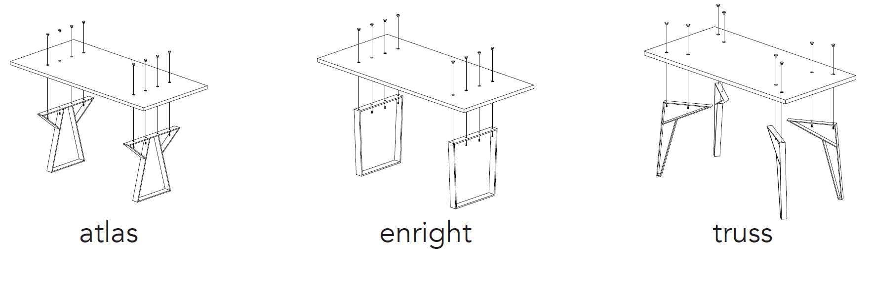








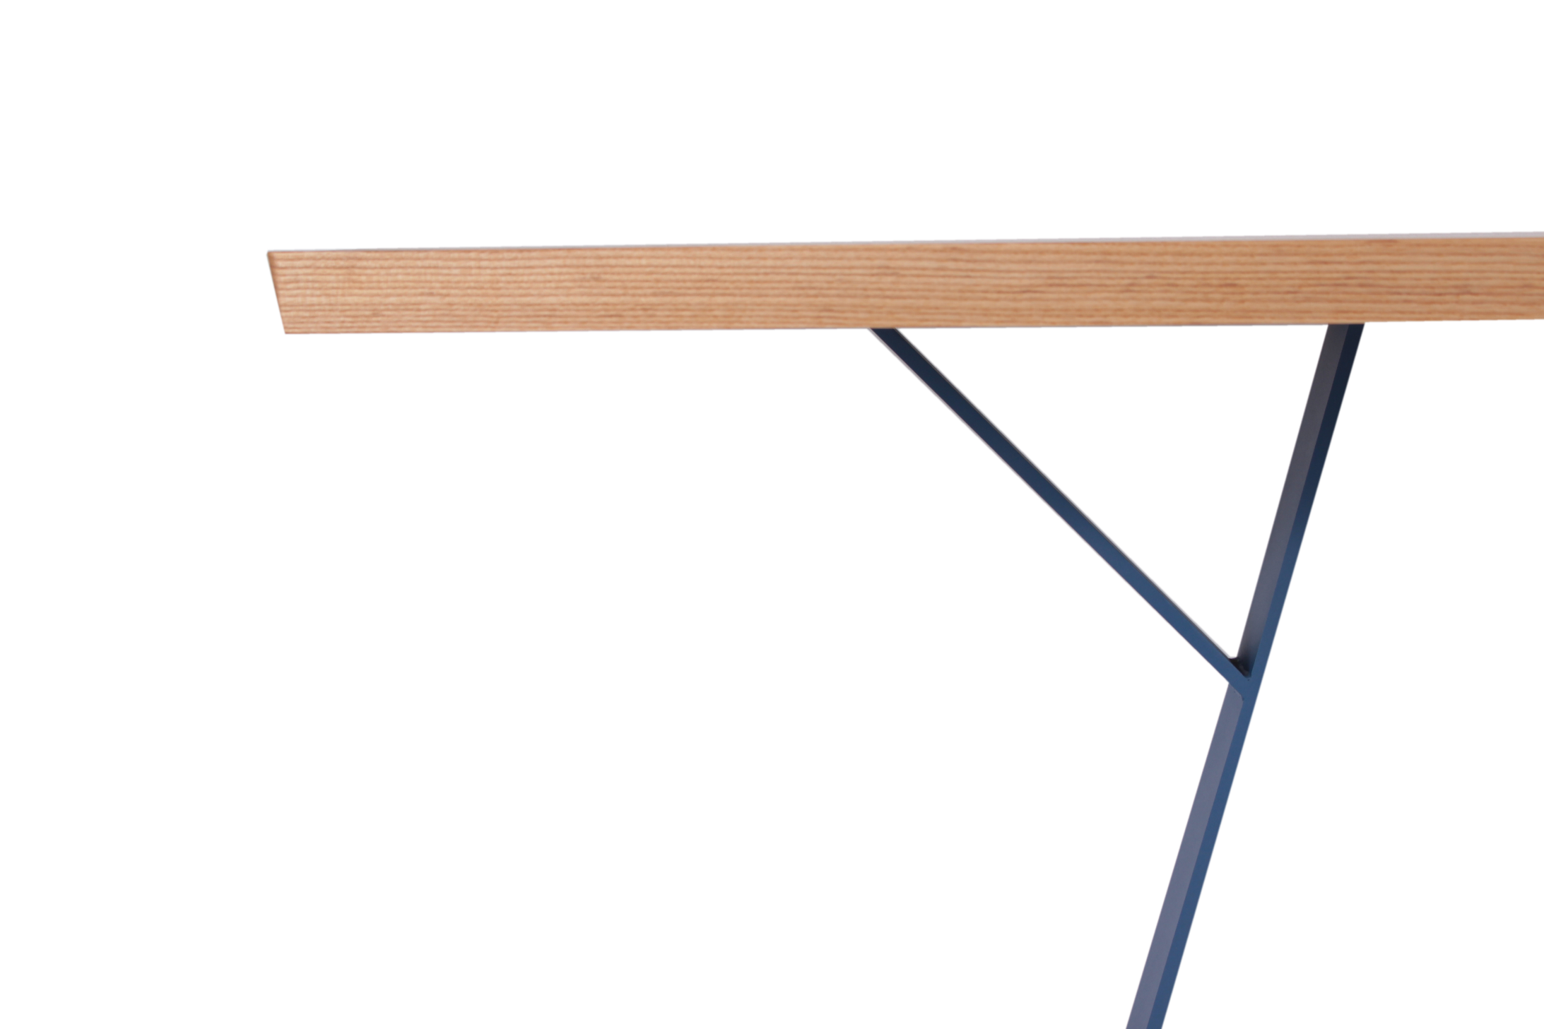
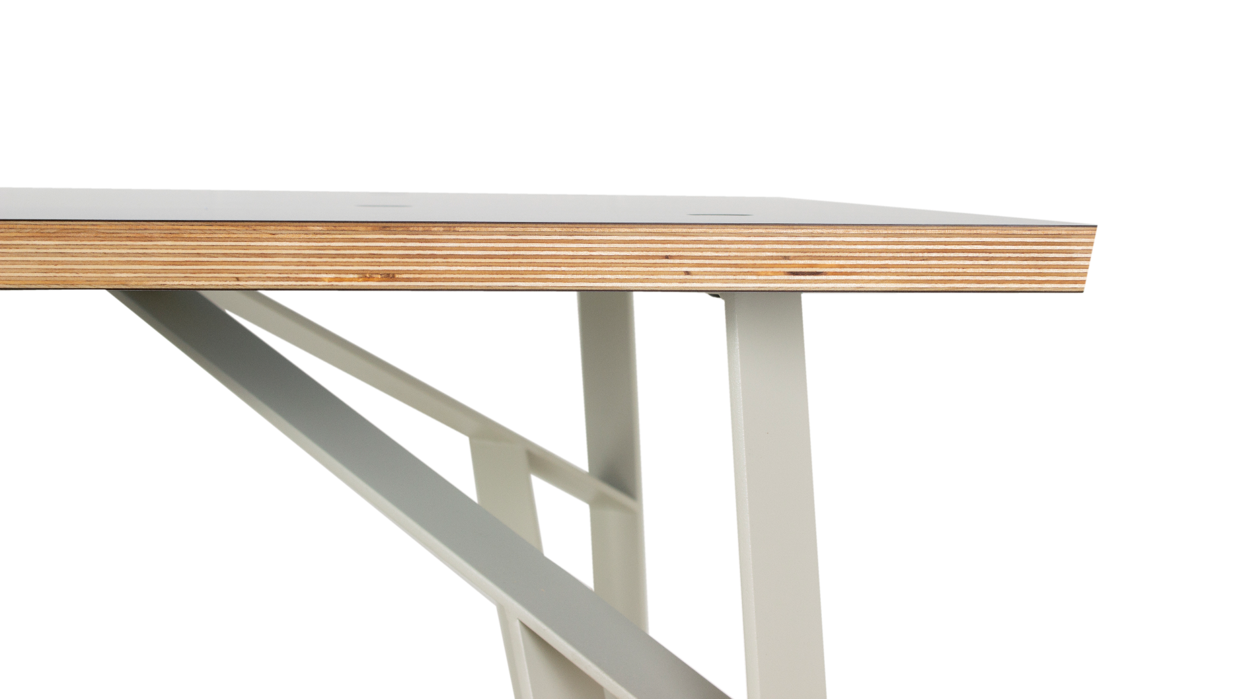
Leg style
Leg color
Wood species
Europly
Hardwood

Slide 9
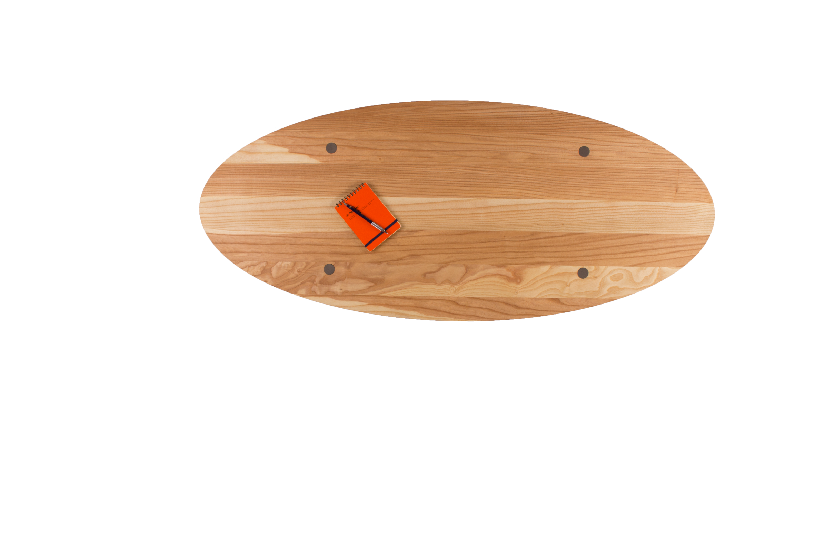
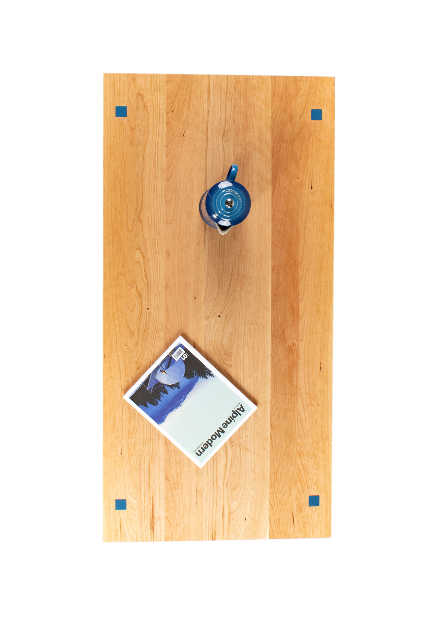
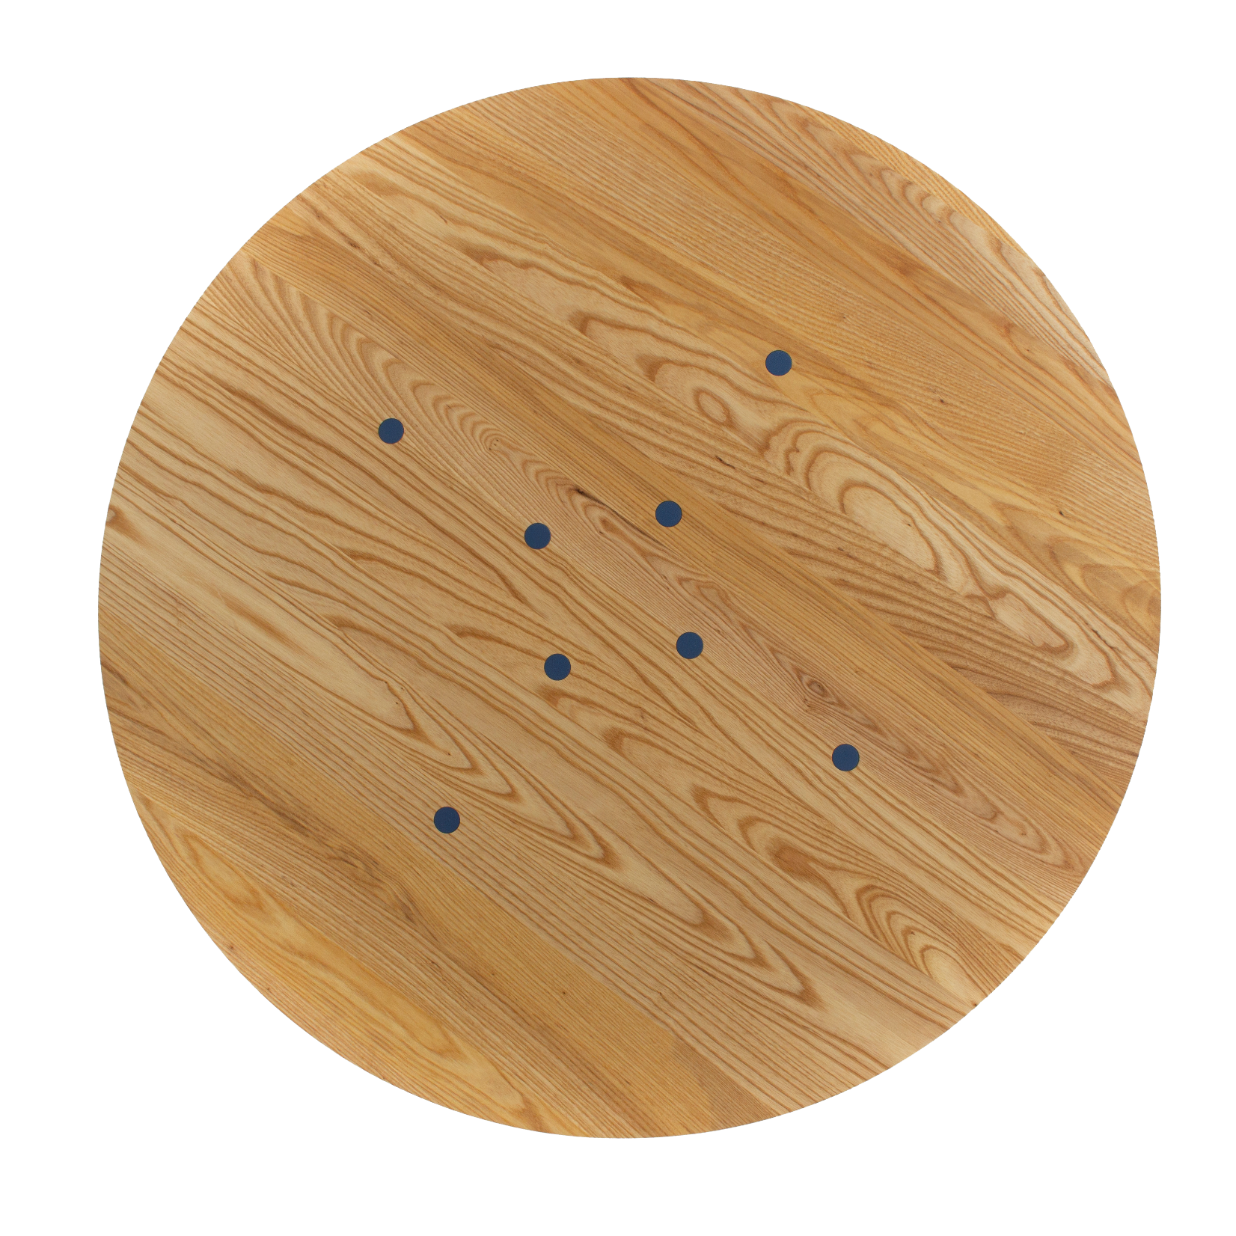
Shape & Size

Slide 10
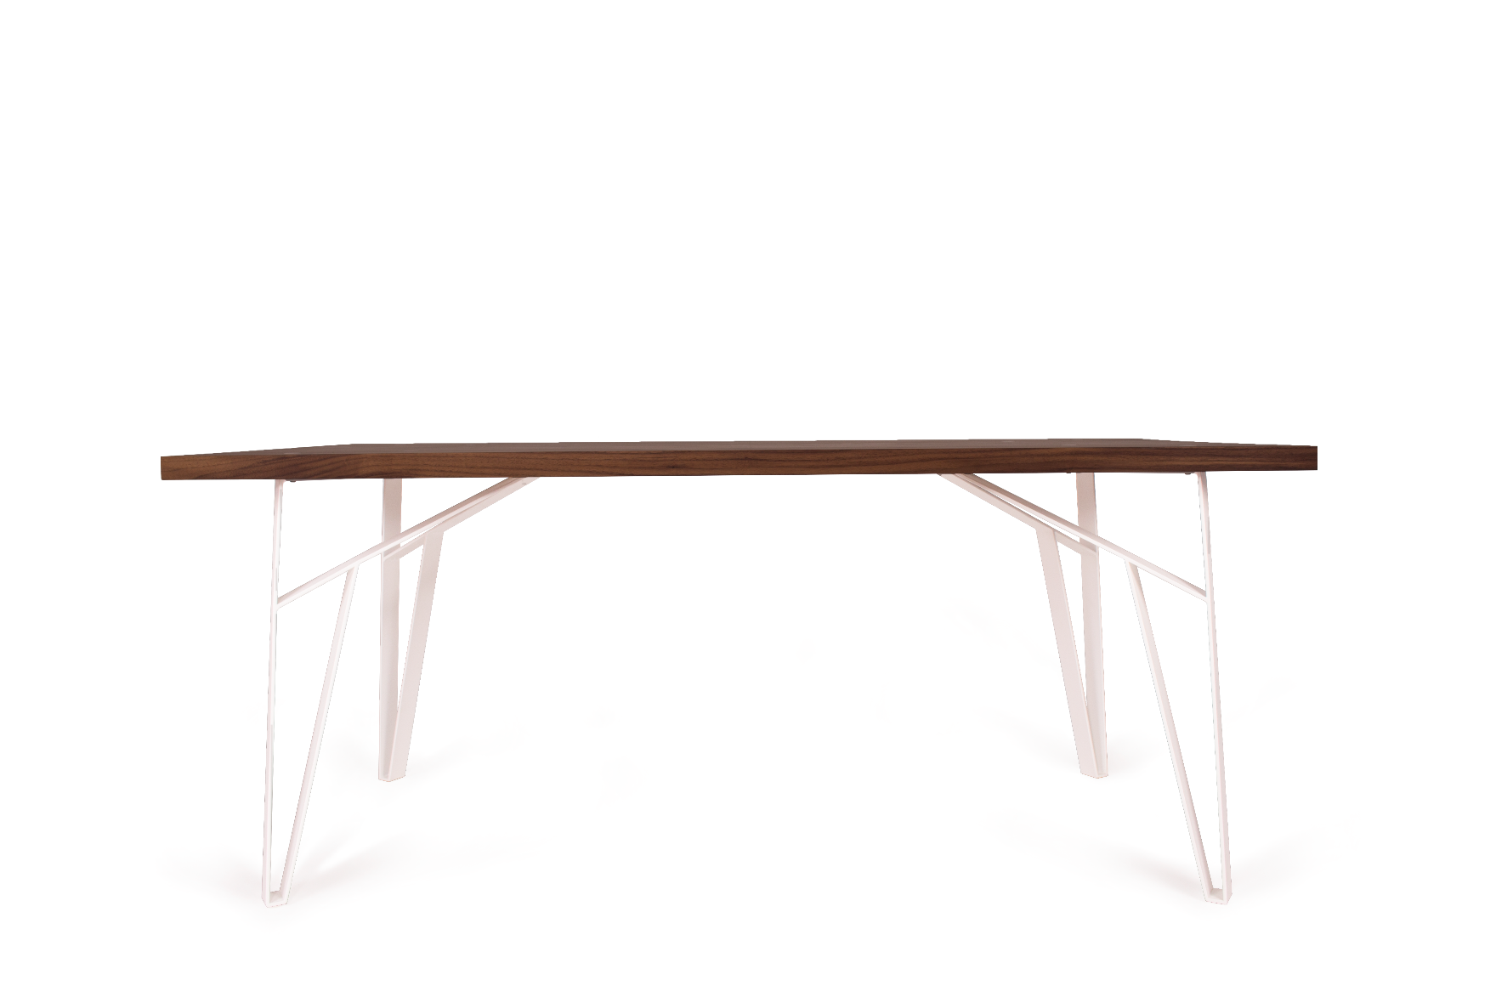
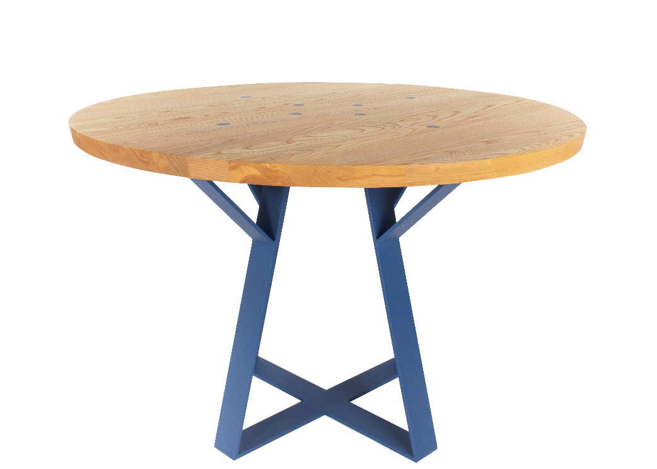
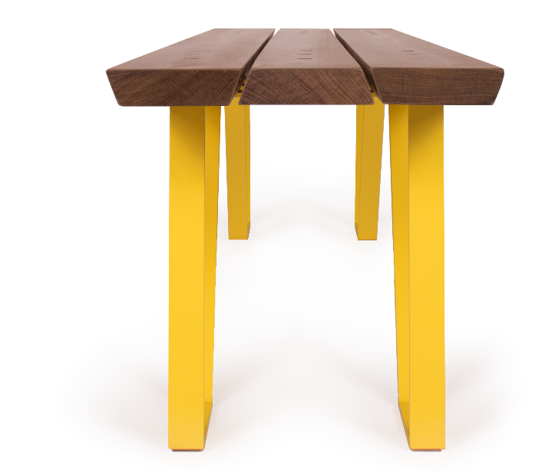
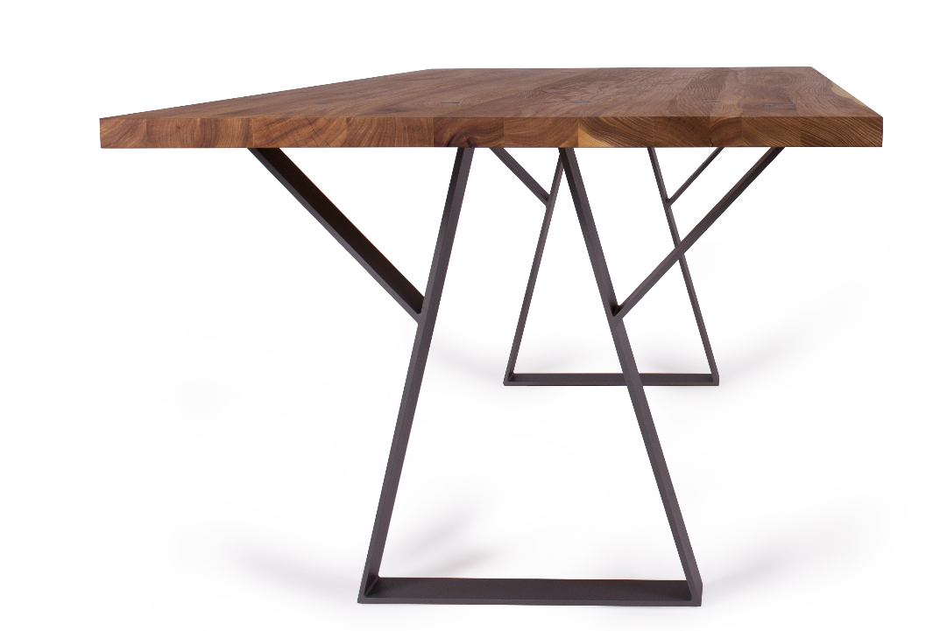
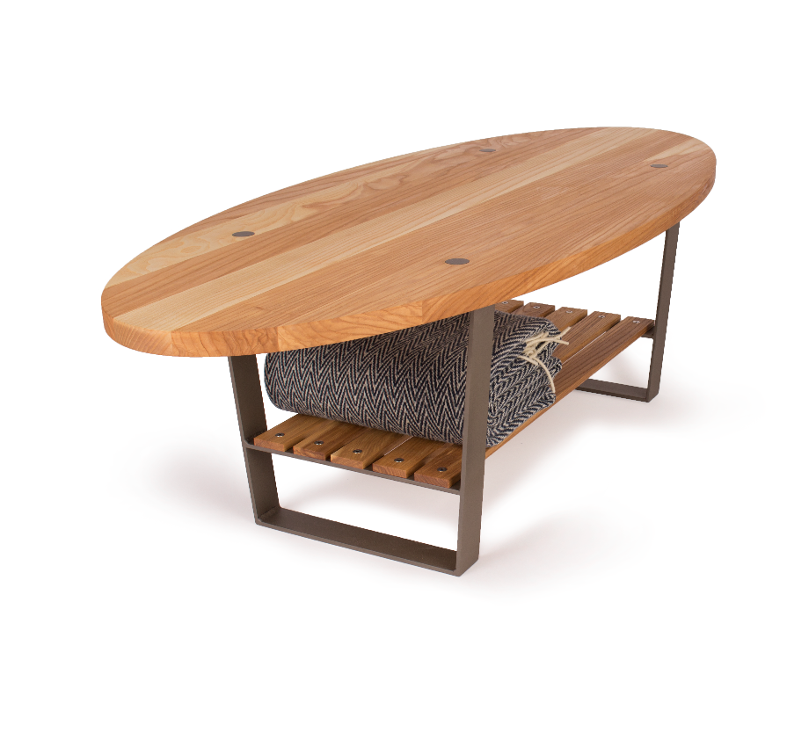
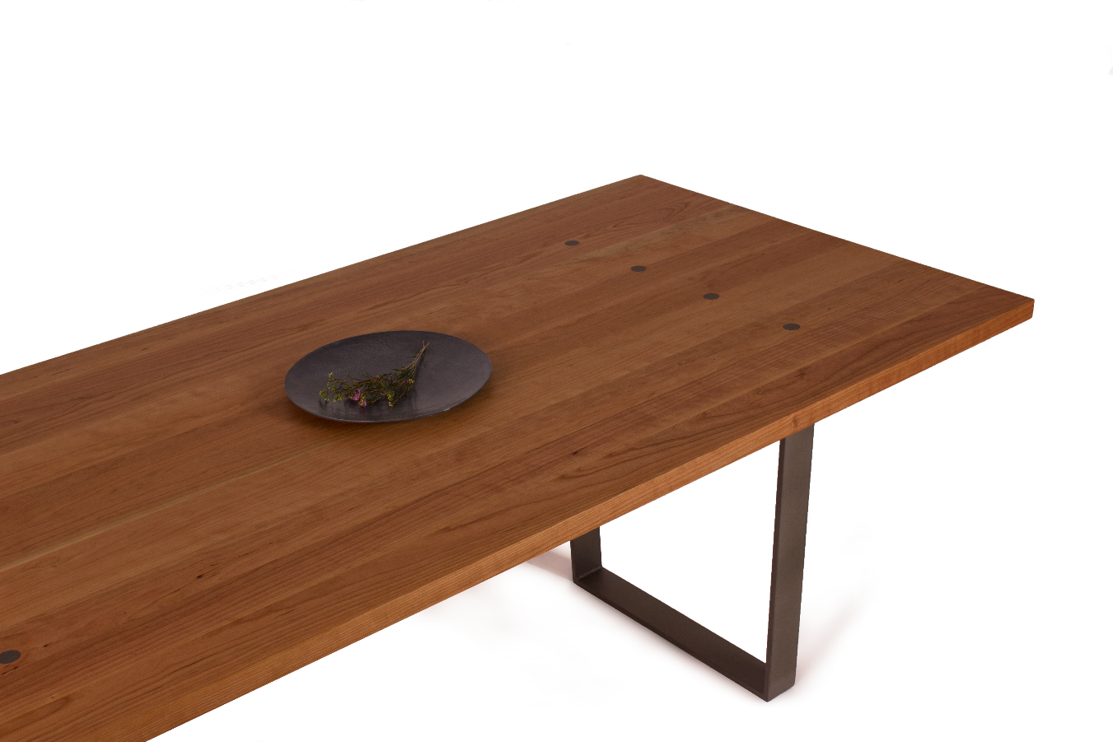
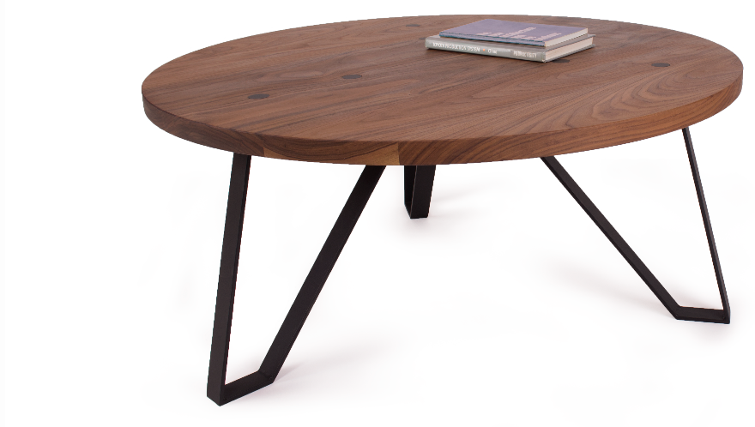
Tables

Slide 11
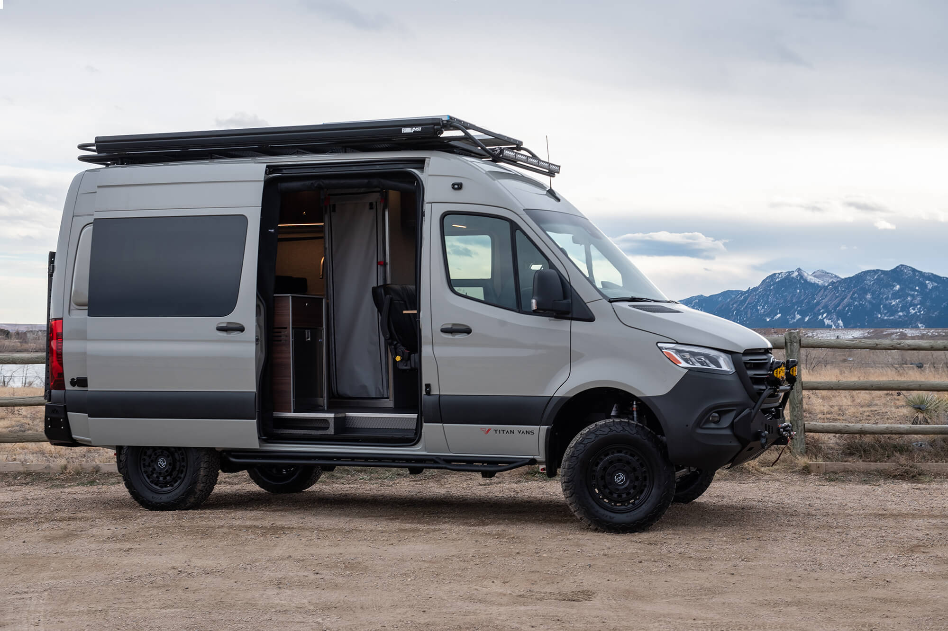
Fall 2018: Formed additional business Boulder CNC, a CNC job shop
Titan Vans became Boulder CNC customer.
ENGINEERING
Our engineering and production processes consist of advanced computer aided design and digital manufacturing. We design and manufacture our components in-house, giving us full control over quality and compatibility within our systems.
MODULARITY
Components designed to be easily removable and adaptable to the needs of different adventures. Kitchens, cabinets, beds, seats, and hanger fittings engineered to be removed as needed.
CRAFTSMANSHIP
Many components are manufactured in-house to ensure maximum quality control. Our team uses state-of-the-art tools to create precision components, ranging from electrical and plumbing to cabinetry and metalwork.

Slide 12
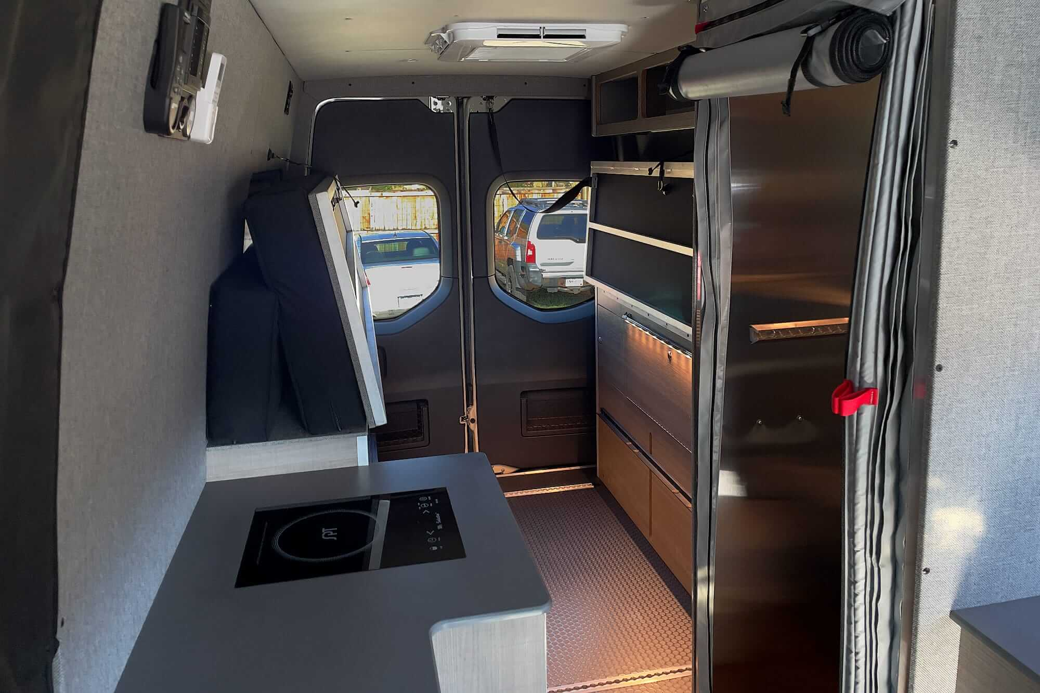
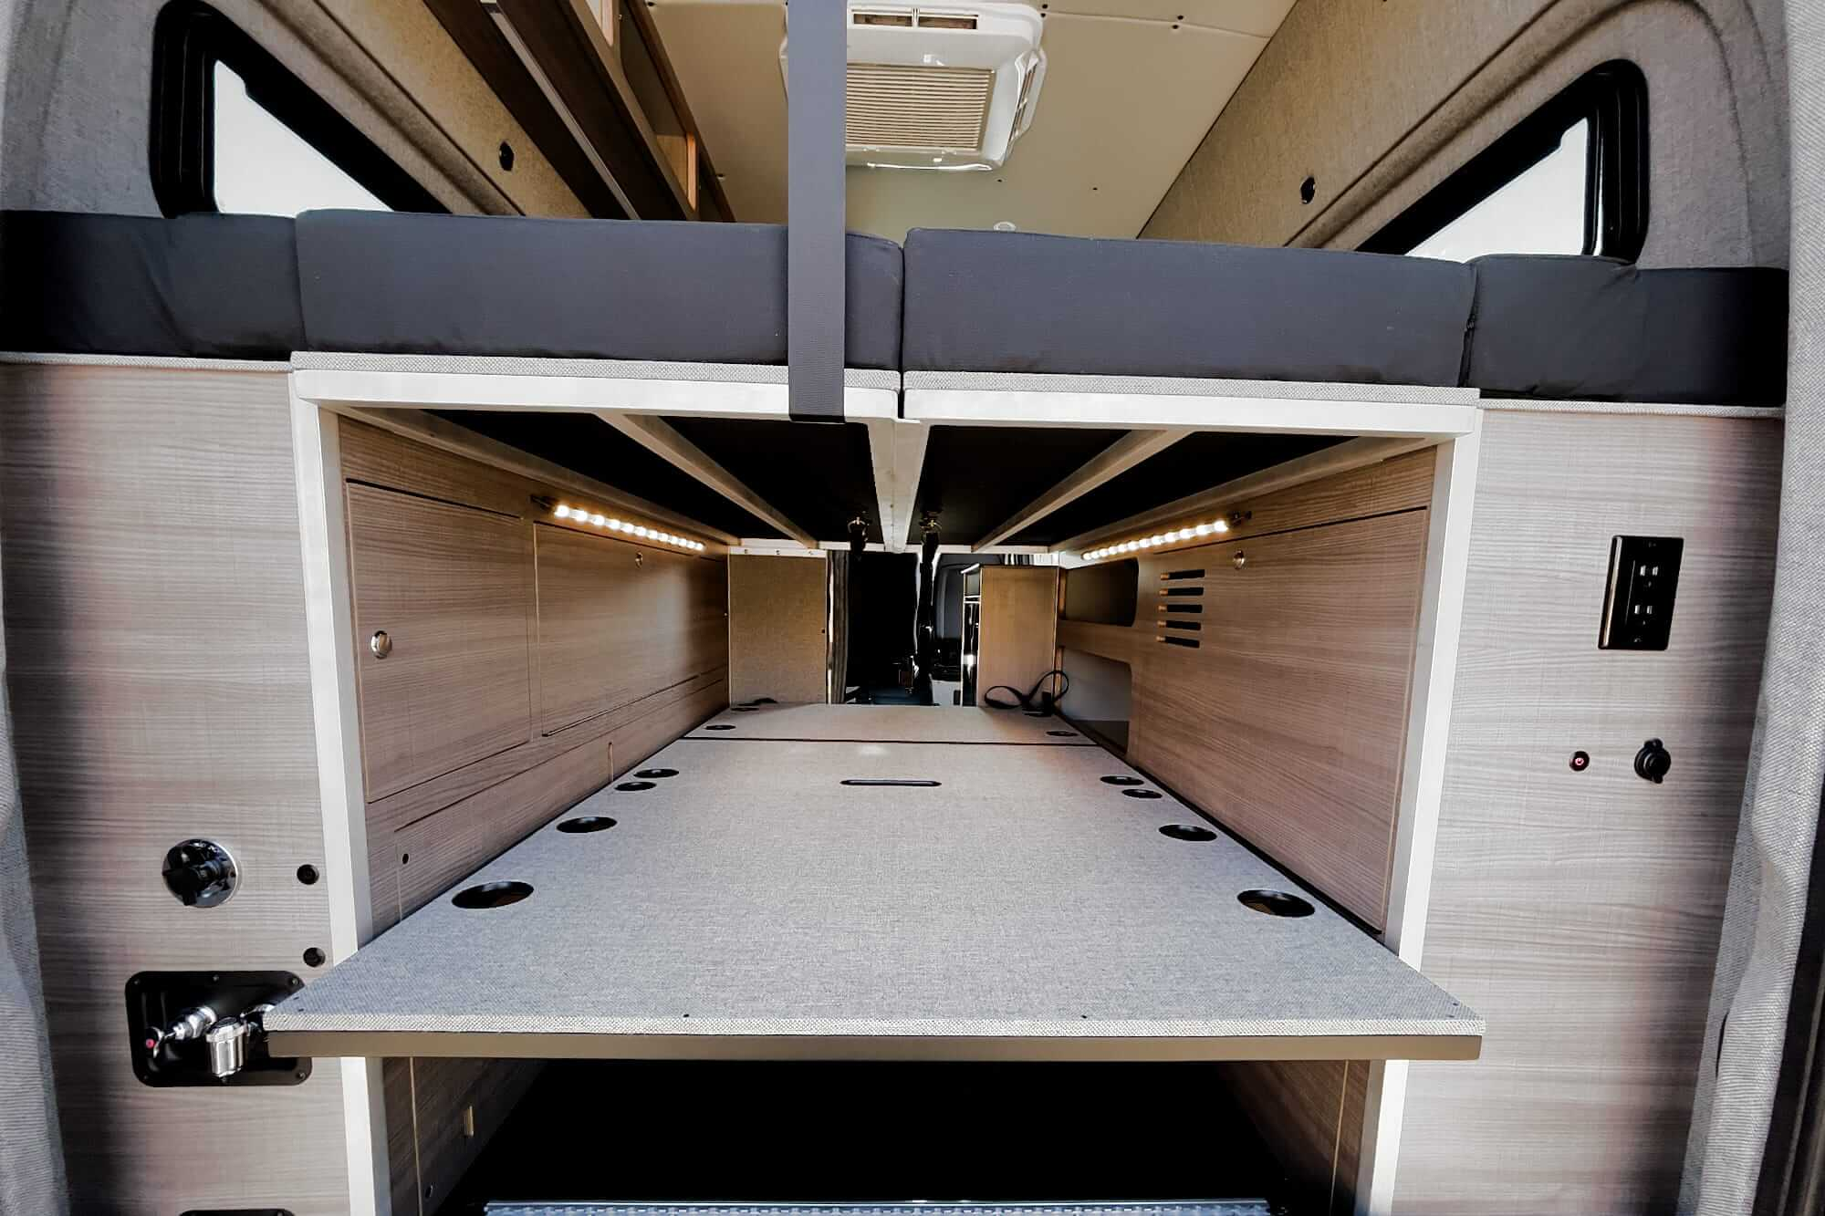

Slide 13
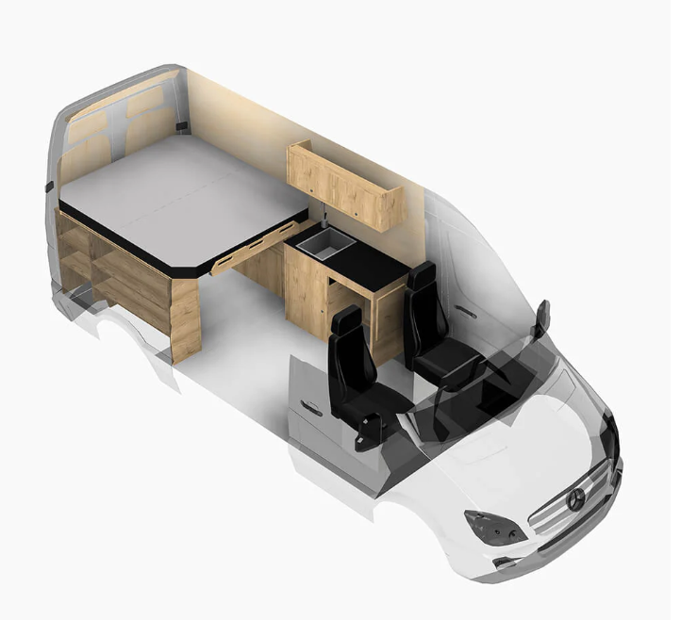
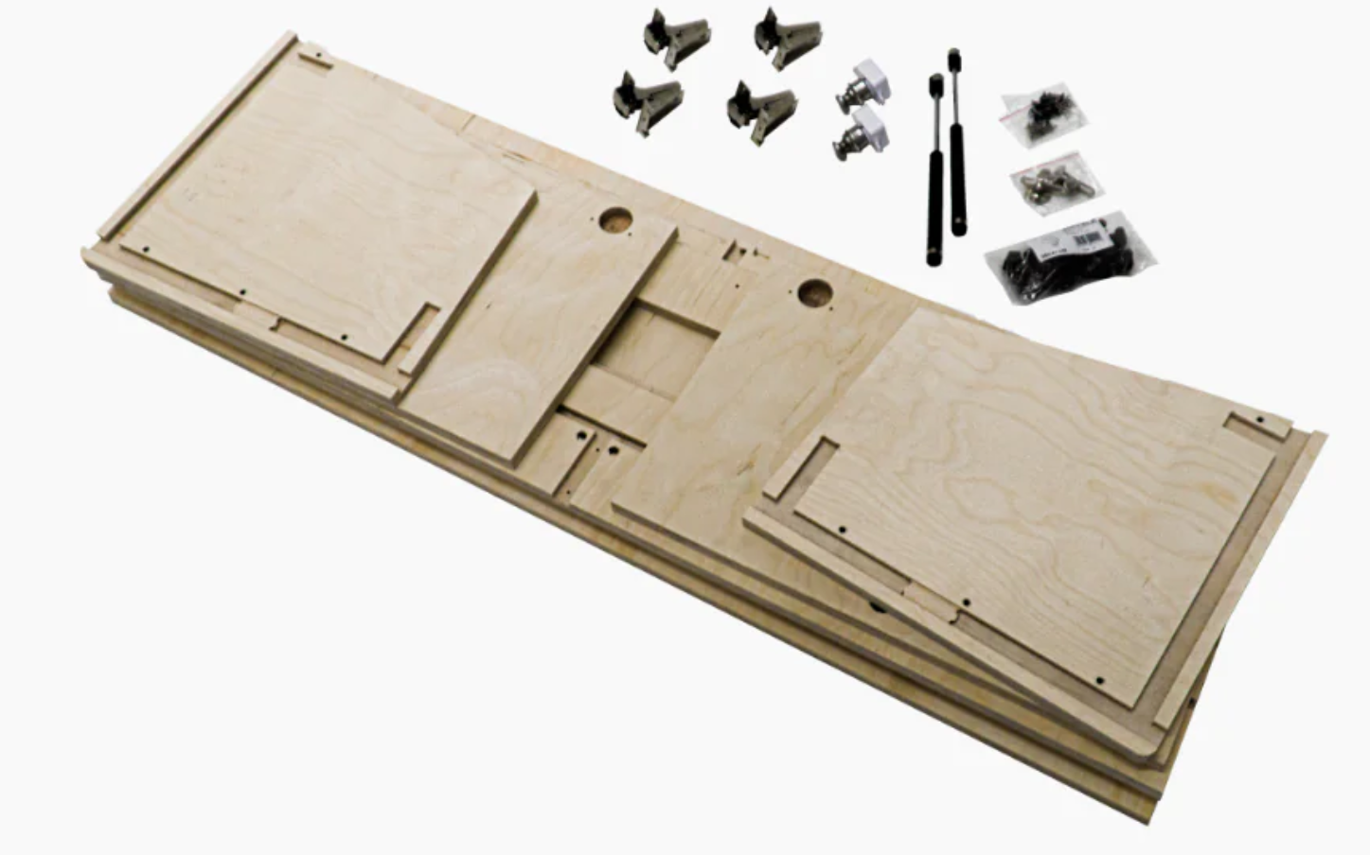
Spring 2020: Assisted in creation of Titan DIY Kits.
Simplified versions of Titan Vans designs for ease of assembly and durability
All designed for flat pack and affordability

Slide 14
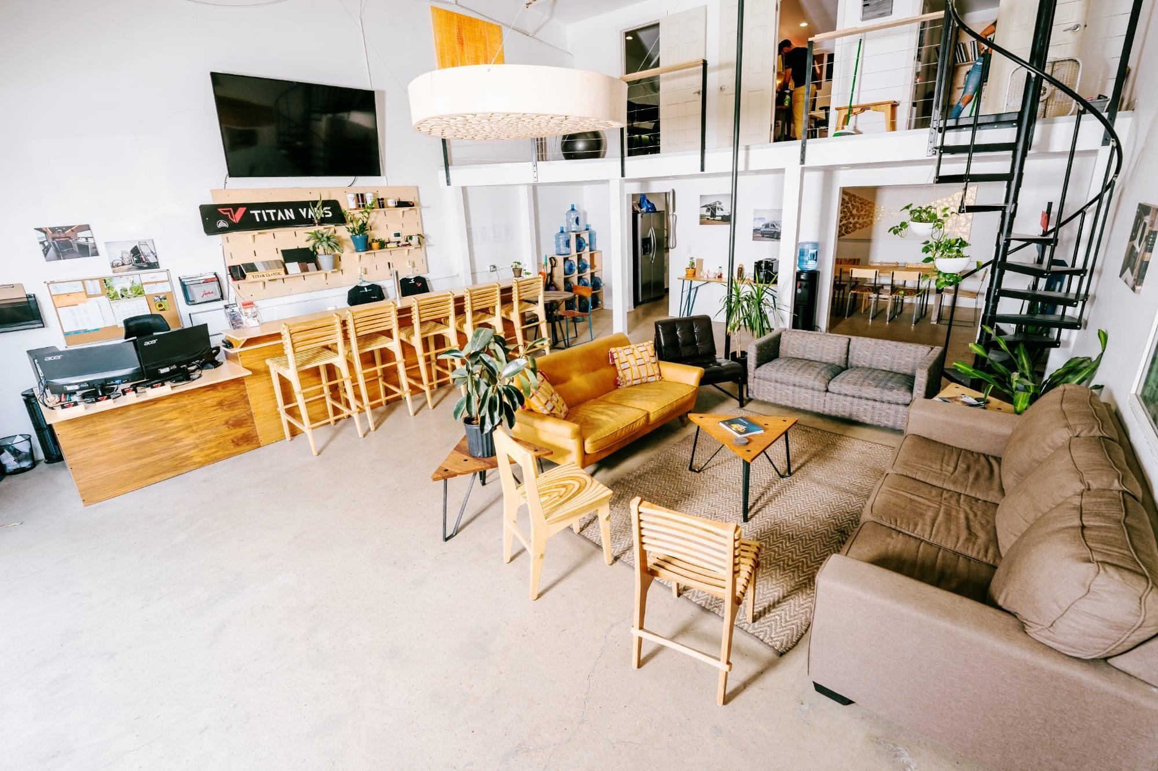
January 2021: Merged ATLA & Boulder CNC with Titan Vans

